Slide 1
Microsoft Power Automate Empowerment
Notes:
Hi, Welcome to Microsoft Power Automate Empowerment

Slide 2






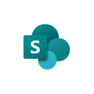
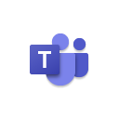




Jenkins NS
Modern Workplace Solution Architect | Consultant
Microsoft Teams, Power Platform and SPFx Specialist
International Speaker | Blogger | Trainer
SPS Bangalore Organizer
aOS Ambassador
jenkinsns@gmail.com
in/jenkinsns
@jenkinsns
http://www.jenkinsblogs.com
jenkinsns
https://www.facebook.com/spfxinfo/
https://www.facebook.com/msteamsinfo

Slide 3
Course Overview
Day 1
Empowering everyone with Power Platform
Introduction to Power Platform
Day 2
Power Automate Introduction
Microsoft Flow Basics
Day 3
Power Automate Project Scenarios
Approve / Reject Workflow Scenario
Day 4
Monitoring & Administration of Power Automate
Import, Export Flows
Microsoft Power Platform momentum
Why Power Platform?
Customer Stories
Power Platform Components Demo
Power Platform Account Setup
Microsoft Flow Templates
Decision Making with Flow
Building Workflows with Power Automate
Hands on Lab - Microsoft Flow
Conditions, Switches, Scope & Context of Decision-Making Control Elements
User Input Acceptance & Validation Workflow Scenario
Recurrance Workflow Scenario
Dynamic 365 Integration Workflow Scenario
Azure Cognitive Services AI Integration Workflow Scenario
Power App Integration Workflow Scenario
SQL Server Integration Workflow Scenario
HoL - End to End Business Flow with all Scenarios
Distribute Flows
Sharing of Flows across workspaces
Different Flow Environments and Code Promotion
Data Policies & Integration Check Points
Flow History and Analytics
HoL - Check your Knowledge

Slide 4
Day1: Empowering everyone with Power Platform

Slide 5

Agenda
Introduction to Power Platform
Microsoft Power Platform momentum
Why Power Platform?
Power Platform Components Demo
Customer Stories
Power Platform Account Setup

Slide 6

Notes:
It starts with how they get the most out of their business data
Data is everywhere – generated at every step of our lives
90% of world’s data generated in last 3 years alone
Everything we do, everything our customers do, everything competitors do generates some kind of data
T: In the old world, that data lived in siloes

Slide 7
Low Code Evolution

Slide 8

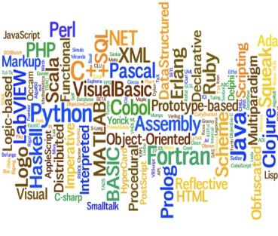


The evolution of how people buy applications
Custom Software
Packaged Software
Low-code Development
What development language do you use?
How feature rich is your software?
How agile and extensible is your platform?
ERP
CRM
HRM
ERP
CRM
HRM
Middle
-ware
MRP
Middle
-ware
PRM
MRP
PRM
MRP
OPS
LOG.
…
OPS
PRM
…

Slide 9
Benefits of low-code development platforms
Environment used to create web or mobile applications easily by mostly configurations, drop-and drops.
LOW-CODE
DEVELOPMENT PLATFORMS
Higher rate of success
Loved by both Business & IT
Breeds Innovations
Days to Weeks
Success Rate
Time to Live
Business Relevance
Innovative Culture
Traditional computer programming, writing lines of codes from scratch.
Failed projects are common
Lagging IT & constant tension with business
TRADITIONAL
DEVELOPMENT
Months to Years
Curbs Innovation

Slide 10






Who buys Power Platform?
“We need faster growth.”
“I need my teams to do a lot more with a lot less.”
CXOs
GROWTH
CFOs
EFFICACY
“We are shackled by our legacy tech. & it’s too risky to migrate!”
“Most of my employees are not desk-bound nor IT-savvy”
CIOs
INNOVATION
BDMs
ACCESSIBILITY
“So many disparate businesses with M&A, I don’t know how to start to integrate.”
“Too many manual or redundant processes because company’s IT or systems don’t work for us.”
COOs
CONSOLIDATION
Users
CITIZEN PAINS

Slide 11
Power Platform loved by businesses in all segments
Enterprise
Corporate
Midmarket
Small
Innovation platform – justify once, unlimited innovations forever
Easy first step to your digital transformation journey
Breeds unique & inclusive IT and Business innovation culture with citizen development philosophy
One Microsoft Story – MS understands business of Platforms
Company-wide digitized with easy-to-use mobile/IoT enabled applications even for frontline workers
Significantly lowered cost of automation, digitization and innovation
Fuss-less continuous innovations with citizen development capabilities
Easy to create, easy to retire, easy to change

Slide 12



Microsoft Power Platform
The low-code platform that spans Office 365, Azure, Dynamics 365, and standalone applications
Innovation anywhere. Unlocks value everywhere.
Power BI
Business analytics
Power Apps
Application development
Power Automate
Process automation
Power Virtual Agents
Intelligent virtual agents
Data connectors
Portals
AI Builder
Common Data Service

Slide 13
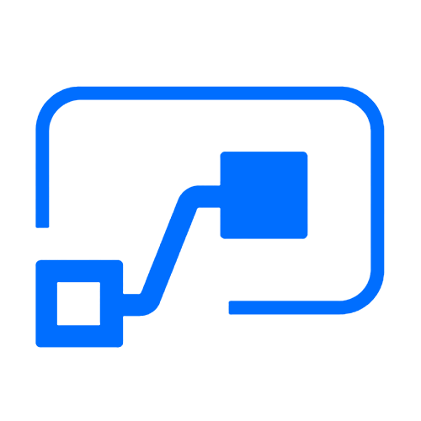

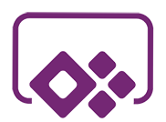

Who here has a Microsoft 365 background?
SharePoint, Teams, Exchange…
Microsoft 365
Analyze
Act
Automate
Data connectors
Power BI
Business analytics
Power Apps
Low-code/no-code application development
Power Automate
Workflow automation
Standalone apps
Common Data
Service
AI Builder

Slide 14
What about a Dynamics 365 background?
Sales, Service, Talent…
Microsoft 365
Dynamics 365
Analyze
Act
Automate
Data connectors
Power BI
Business analytics
Power Apps
Low-code/no-code application development
Power Automate
Workflow automation
Standalone apps
Common Data
Service
AI Builder

Slide 15
Last, but not least, what about Azure?
Azure SQL, Azure Functions…
Microsoft 365
Dynamics 365
Microsoft Azure
Analyze
Act
Automate
Data connectors
Power BI
Business analytics
Power Apps
Low-code/no-code application development
Power Automate
Workflow automation
Standalone apps
Common Data
Service
AI Builder

Slide 16
Why Power Platform?
Time
Resources
Cost
Data
Maintenance

Slide 17
Power Platform Components

Slide 18




Let’s talk about data
Analyze
Power BI
Know
Act
Automate
Power Apps
Automate
AI Builder
Learn

Slide 19
Let’s talk about data
Analyze
Power BI
Know
Act
Automate
Power Apps
Automate
Connectors
AI Builder
Learn

Slide 20

Let’s talk about data
Analyze
Power BI
Know
Act
Automate
Power Apps
Automate
CDS
AI Builder
Learn

Slide 21

Two Types of Data. . .
External
Internal

Slide 22
Two Types of Data. . .
Connectors
Common Data Service

Slide 23
Oh, the apps you can build. . .
Client | Connectors | Common Data Service
Power Apps (Canvas) | Yes | Yes
Power Apps (Model) | No | Yes
Power Portals | No | Yes
Flows | Yes | Yes
AI Builder | No | Yes
PowerBI | Yes | Yes

Slide 24
Why external data (Connectors)?
It’s easy
It’s home

Slide 25

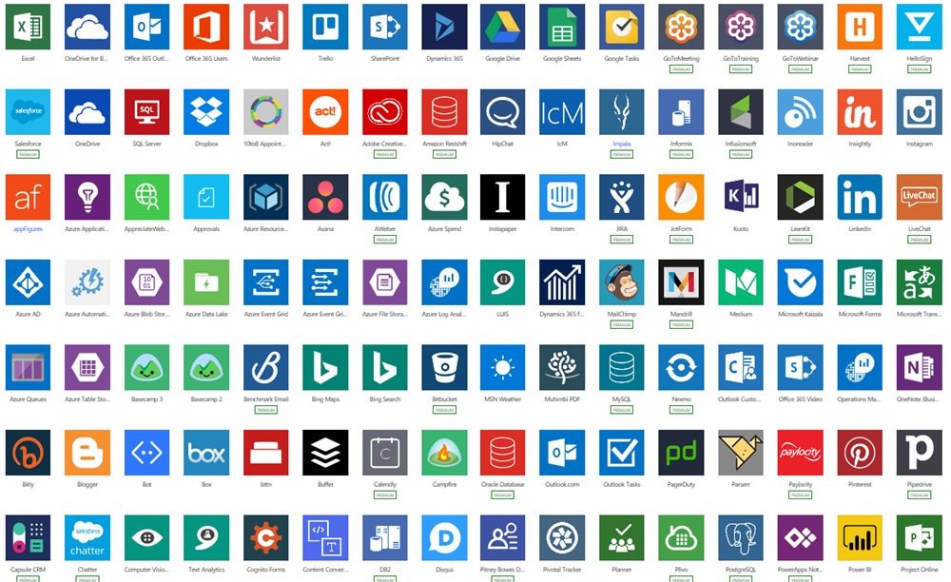
Why external data (Connectors)?
Built-in connectivity to 275+ cloud services, content services, databases, APIs, etc.
Seamless hybrid connectivity to on-premises systems via the on-premises data gateway.
Develop and register custom connectors as a building block for citizen developers.
Connect data silos by using multiple data sources in a single application.

Slide 26
Why internal data (Common Data Service)?
It’s smart
It scales
It’s secure

Slide 27
What is the Common Data Service?
The Common Data Service easily structures
a variety of data and business logic to support
interconnected applications and processes
in a secure and compliant manner

Slide 28
What is the Common Data Service?
The Common Data Service easily structures
a variety of data and business logic to support
interconnected applications and processes
in a secure and compliant manner

Slide 29
What is the Common Data Service?
The Common Data Service easily structures
a variety of data and business logic to support
interconnected applications and processes
in a secure and compliant manner

Slide 30
What is the Common Data Service?
The Common Data Service easily structures
a variety of data and business logic to support
interconnected applications and processes
in a secure and compliant manner

Slide 31
What is the Common Data Service?
The Common Data Service easily structures
a variety of data and business logic to support
interconnected applications and processes
in a secure and compliant manner

Slide 32
What is the Common Data Service?
The Common Data Service easily structures
a variety of data and business logic to support
interconnected applications and processes
in a secure and compliant manner

Slide 33
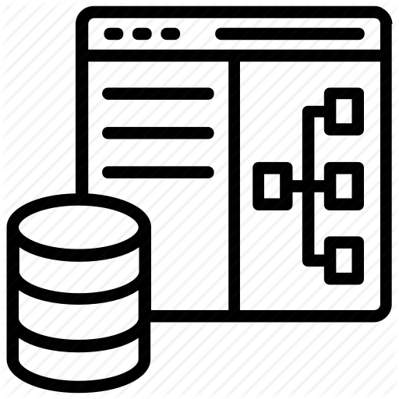
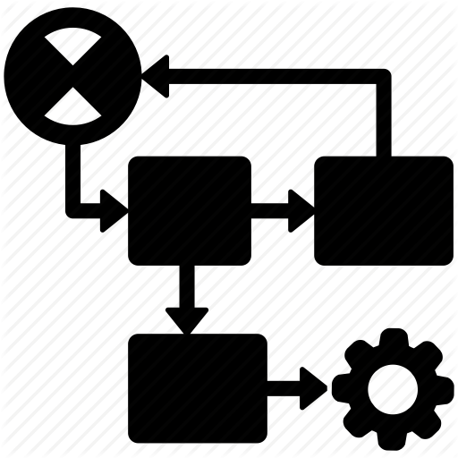






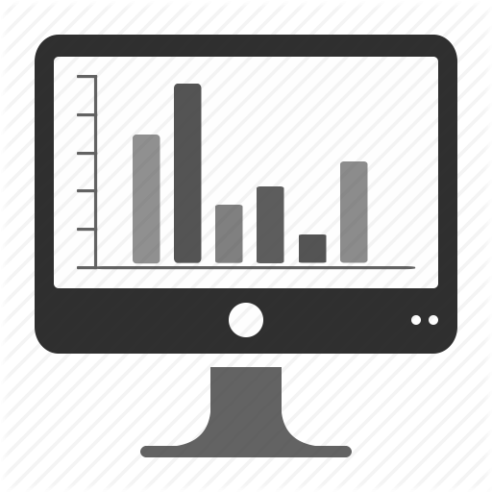











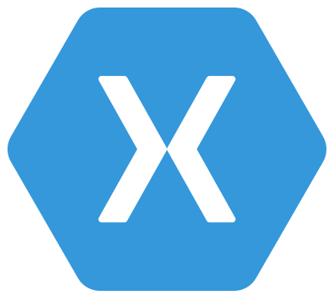

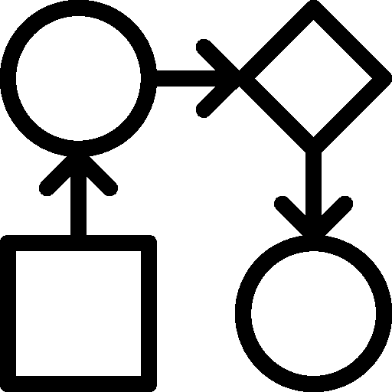
Common Data Service: What’s in the box
Integration
Storage
Relational
databases
Eventing
Data
Catalog
and discovery
Files and
blobs
Logic
Log files
Webhooks
Jobs
Modelling
Security
Reporting
Semi-structured
data
Business
Rules
API
Calculated &
Rollup fields
Authentication
Duplicate
Detection
Data
validation
Search and
Find data
Authorization
Plugins
Data export
Common Data
Model
Auditing
Workflows
Data lake

Slide 34
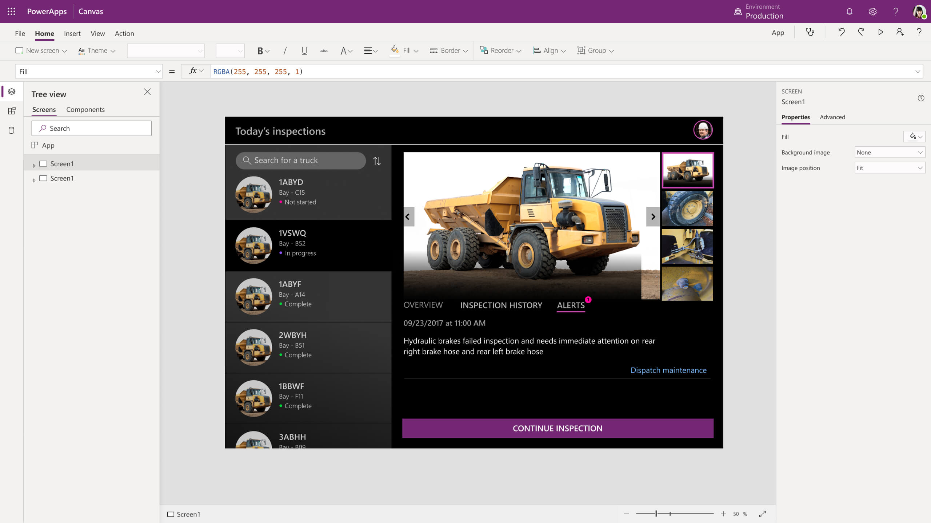
Power Apps
Turn ideas into organizational solutions by enabling everyone to build custom apps that solve business challenges.

Slide 35
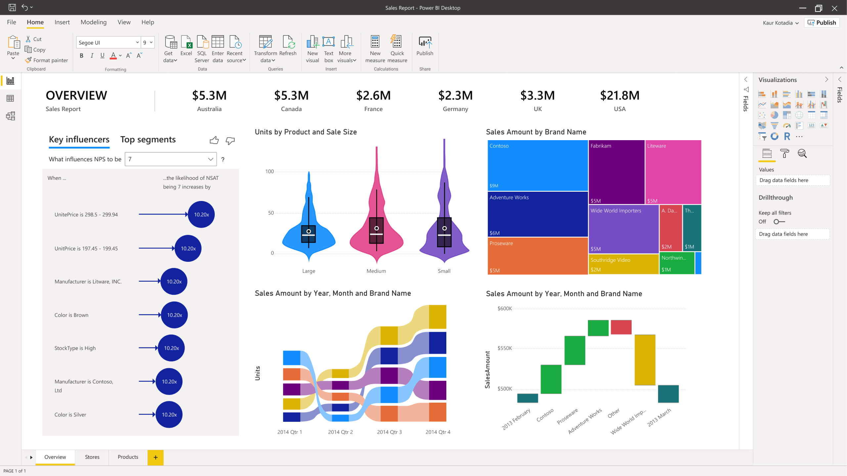
Power BI
Make informed, confident business decisions by putting data-driven insights into everyone’s hands.

Slide 36
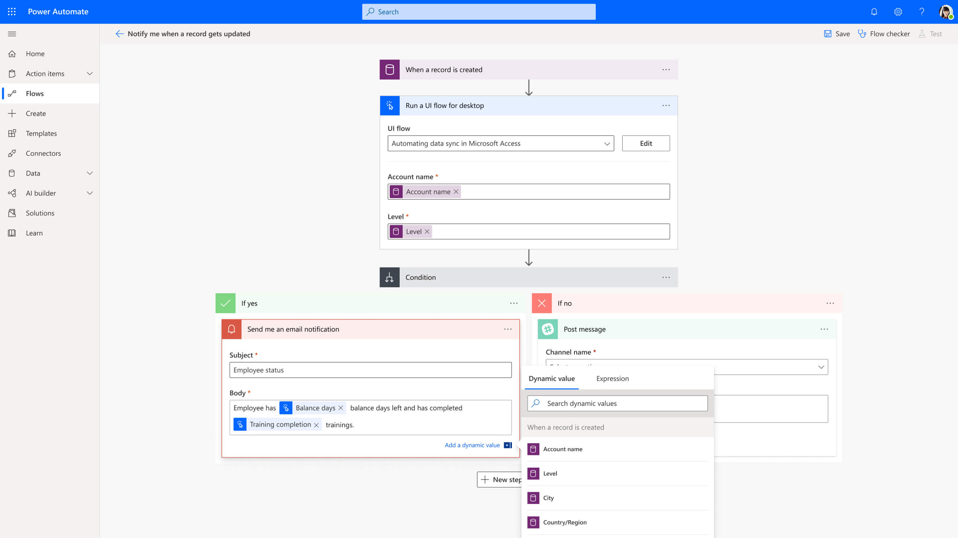
Power Automate
Boost business productivity to get more done by giving everyone the ability to automate organisational processes.

Slide 37
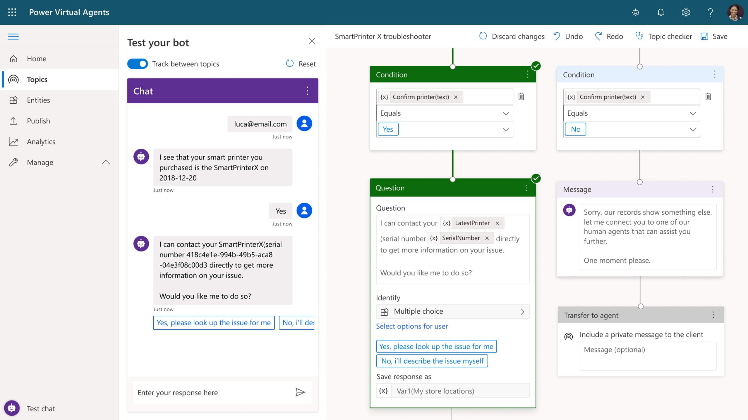
Power Virtual Agents
Easily build chatbots to engage conversationally with your customers and employees—no coding required.

Slide 38
Customer Stories

Slide 39


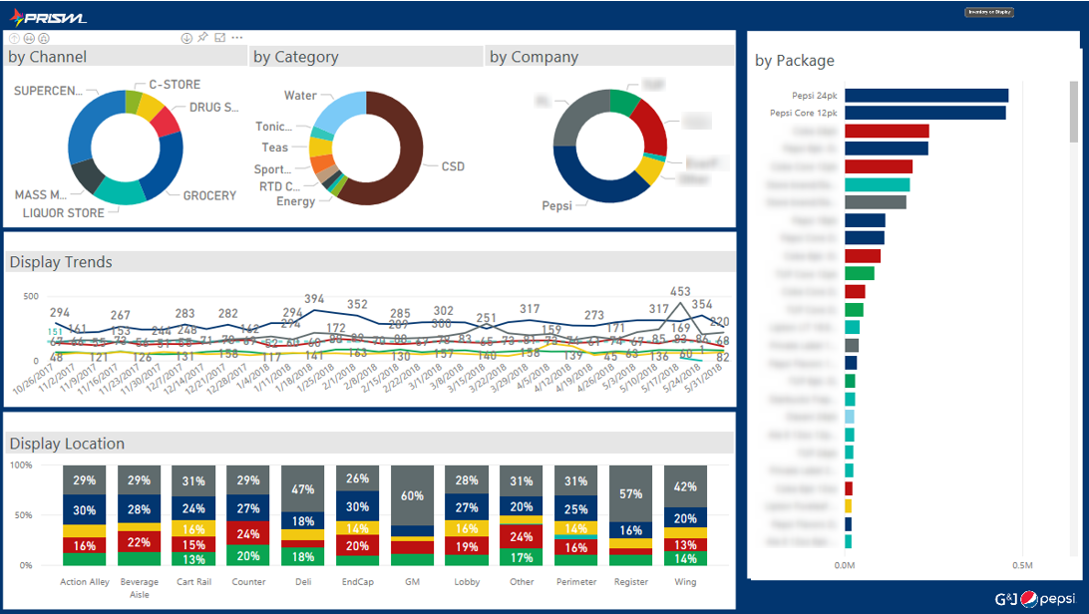
Building apps that save money
A small team at G&J Pepsi with no previous app-development experience created auditing apps that saved the company $500,000
https://customers.microsoft.com/en-us/story/gj-pepsi-consumer-goods-powerapps

Slide 40


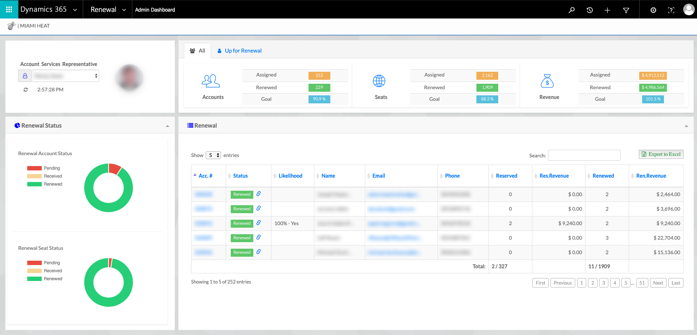
Customer: Miami HEAT
Industry: Media and Entertainment
Size: 50–999 employees
Country: United States
Products and services: Microsoft Dynamics 365 Sales
Microsoft Power BI
Microsoft Azure
Read full story here
“After we implemented the data warehouse and Dynamics 365, we had a 30 percent year-over-year increase in our season ticket sales with essentially the same team on the floor.”
—Matthew Jafarian, Executive Vice President of Business Strategy, Miami HEAT
The Miami HEAT is always trying to make fan experiences even better. In the past, inefficient data collection and analysis sometimes delayed decision-making and made it hard to understand fan needs and expectations.
The HEAT adopted Microsoft Dynamics 365, Power BI, and Azure. The HEAT now aggregates 360-degree fan profiles to personalize fan communications, and it uses Adobe Marketing Cloud to harness the profiles to personalize digital experiences.
With better views into its data, the HEAT streamlined fan experiences networking. With Power BI insights, the organization saved approximately $1 million with simple operational changes, and 360-degree profiles in Dynamics 365 have helped drive a 30 percent increase in season ticket sales.

Slide 41


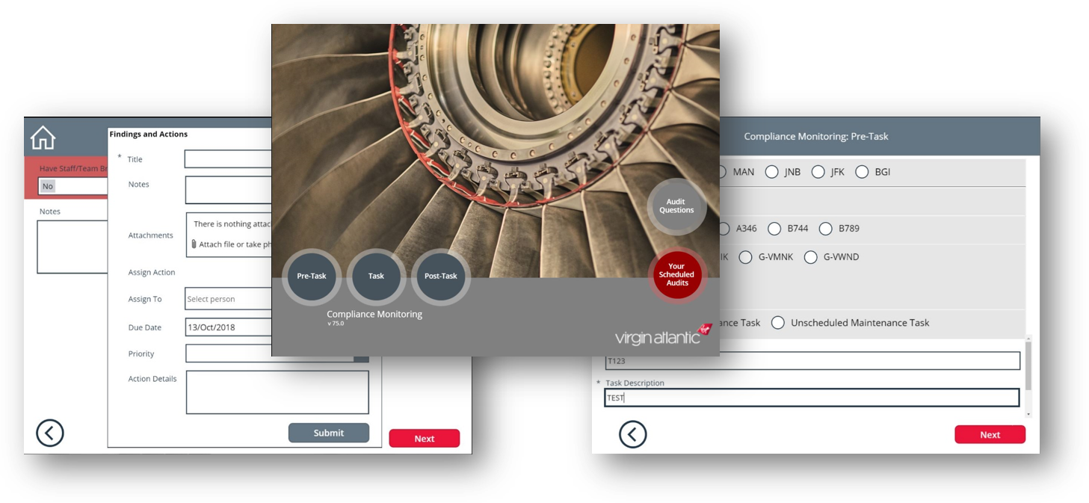
Boosting customer satisfaction
Virgin Atlantic creates custom-built mobile apps to continually improve the start-to-finish travel experiences of 5 million passengers a year.
https://customers.microsoft.com/en-US/story/virgin-atlantic-travel-and-transportation-power-apps

Slide 42




Vehicle glass repair provider digitizes processes and increases productivity with self-developed apps
Harmony to update image and add published link
Belron® is the worldwide leader in vehicle glass repair and replacement through brands such as Autoglass®, Carglass®, and Safelite®. To streamline previously manual and time-consuming processes, the company adopted Microsoft PowerApps, part of the full Microsoft Business Application Platform stack. It now uses more than 40 apps, all developed in-house by just one employee with no programming skills. Used broadly across the business, from HR to field service reps, the apps help the company improve efficiency, save money, and make it easier for staff to operate effectively.
Microsoft PowerApps
Microsoft Flow
Microsoft Power BI
Common Data Service for Apps
Microsoft Office 365
26,300 employees
Consumer Goods
United Kingdom
Notes:
https://customers.microsoft.com/en-us/story/belron-autoglass-consumer-goods-powerapps

Slide 43
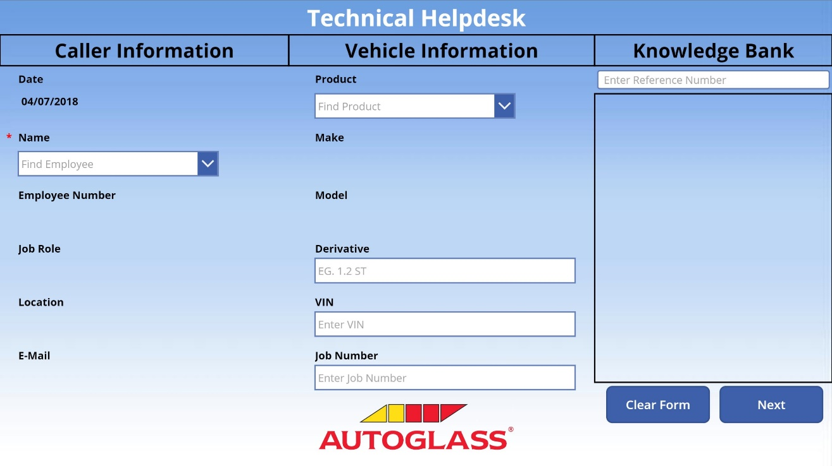
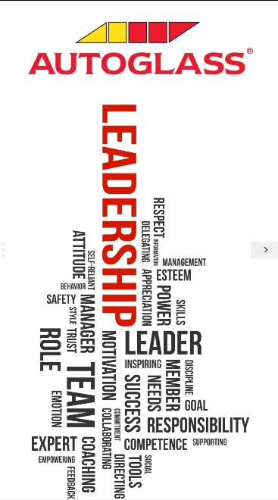
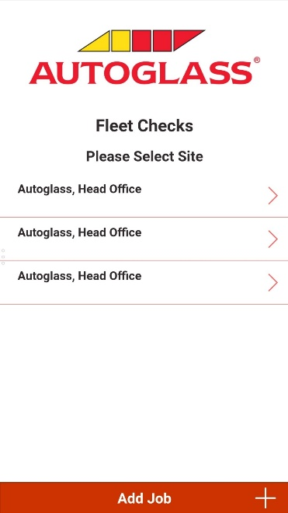
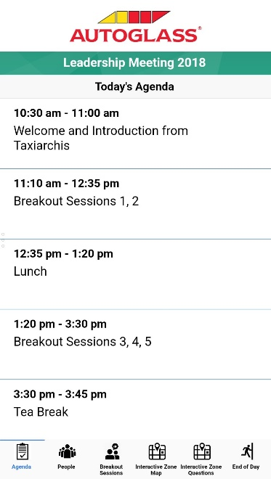
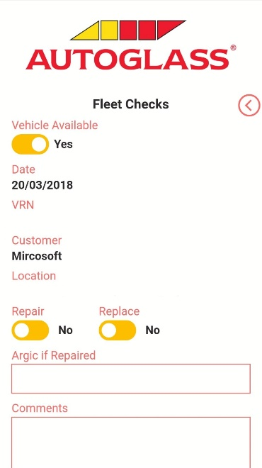
Technical Helpdesk App
Leadership App
Fleet Checks App
PowerApps
Microsoft Flow
Microsoft Power BI
Common Data Service
Microsoft Office 365
26,300 global employees
Consumer Goods
United Kingdom
N/A
Achieve more together
Anywhere it matters
Simplified for business
Notes:
https://customers.microsoft.com/en-us/story/belron-autoglass-consumer-goods-powerapps

Slide 44


Customer: French National Railway Company (SNCF)
Industry: Travel and Transportation
Size: 270,000 employees
Country: France
Products and services: Microsoft Flow Microsoft PowerApps Microsoft Power BI Microsoft SharePoint Online
Read full story here
“When we implemented and explained the potential of these digital tools, we empowered each employee to innovate and share their ideas on how to improve their work on a daily basis.”
—Magali Dupin, Continuous Improvement and Communication Manager, SNCF
As part of ongoing efforts to improve business productivity, French national railway company SNCF launched an initiative called “Digital for All” to better include employees in digital solution development.
SNCF adopted Microsoft PowerApps, Power BI, and Microsoft Flow, then used internal and online training to foster employee adoption, cultivate internal app experts, and create new, innovative apps that digitize business and maintenance processes.
Tens of thousands of SNCF employees now use more than 150 apps to help simplify and streamline tasks. And the company uses real-time analysis in Power BI to reduce errors, increase reliability, and improve production processes.

Slide 45

Global reach of Microsoft Cloud infrastructure
14
Dynamics and Power Platform geos
North America
Europe
Asia Pacific
Canada
South America
UK
France
India
Japan
Australia
UAE
South Africa
Norway
Switzerland
US Government
Germany
China
Legend:
= Available
= Announced
Notes:
Global reach of Microsoft Cloud infrastructure
Infrastructure strategy is influenced by:
Business demand
Competition
Compliance
Data residency
Local regulations
Security & Technology
Local, sovereign, and global datacenter infrastructure stimulates economic development for both customers and partners alike, enabling companies, governments and regulated industries to realize the benefits of the cloud for innovation, as well as bolstering the technology ecosystem that supports the innovation.
To help meet the needs of customers with unique regulatory or compliance requirements as well as expand our global footprint, we continually launch our cloud services in new infrastructure regions.
Azure services, which are foundational, is made available first new geo, followed by other Microsoft services -- Dynamics 365, Power Platform & Office 365 services.
<click>

Slide 46
A range of cloud offerings
Global cloud unlocks digital transformation around the world
North America
Europe
Asia Pacific
Canada
South America
UK
France
India
Japan
Australia
UAE
South Africa
Norway
Switzerland
US Government
Germany
China
Go Local cloud supports country and region-specific requirements
Sovereign cloud ensures compliance with key restrictions
Legend:
= Available
= Announced
Notes:
A range of cloud offerings
Global cloud: Hyperscale globally connected cloud services. Includes multiple geos addressing specific data residency and compliance requirements
Go Local cloud:
US/EMEA/APAC - A set of datacenters within a country border deployed within a latency defined boundary for synchronous replication if customer data in support of disaster recovery e.g. France / India
Sovereign cloud: Hyperscale cloud services, isolated from global could services. Deployed from a local datacenter to meet unique requirements of a specific market e. China / US Gov
<click>
Photo source: https://www.istockphoto.com/photo/aerial-view-of-hong-kong-gm900611166-248476439

Slide 47



Why move to Microsoft cloud
One version
Always up to date on the latest version
TCO of SaaS vs. On-premise
OPEX vs. CAPEX, free sandbox environments, backups & data recovery included, etc.
Security and compliance
Highly secure by design and compliance leadership with standards and contractual commitments
Notes:
Why move to Microsoft cloud
One version: In July 2018 we announced a change to the way we deliver Dynamics 365 updates that will help you stay current in a consistent, predictable, and seamless manner.
TCO of SaaS vs. On-premise: If you are a Microsoft Dynamics on-premises customer, then you’re cloud ready. Access cutting-edge technology, control costs and complexity, and improve IT productivity by migrating your existing solution to the cloud. This is the cost of your software application including the cost of all supporting products and services, such as ISV solutions, add-on applications, customizations and other integrations to ensure your ERP system is fully inter-operable with existing systems. One big difference from a licensing standpoint is that the cloud is a SaaS that you pay-as-you-go monthly or annually and expense the cost, which is classified as Operating Expense (OpEx). In the case of on-premises applications, you pay a high upfront cost classified as a Capital Expense (CapEx) which is usually depreciated or amortized over several years.
Security and compliance: Get peace of mind knowing your sensitive business data is stored in highly-secure, state-of-the-art data centers owned and managed by Microsoft. Your data will be there when you need it, thanks to a 99.9 percent uptime service-level agreement (SLA).
<click>

Slide 48

Trust
We have a set of foundational principles that guide the way we do business in the cloud
Security
Privacy & Control
Transparency
Compliance
Leading technology and processes
Content encryption
Permissions
Access and mobility options
Usage, management, and protection
Law enforcement requests
Laws, regulations, and key international standards
Microsoft service certifications
Notes:
Trust principles
(This slide is a build)
We have a set of foundational principles that guide the way we do business in the cloud.
<click>
Security:
Your content should be safeguarded from hackers using state-of-the-industry security technology and processes.
Your content should be encrypted in transit and at rest.
<click>
Privacy & control:
Your content should only be used as permitted by you and should not be shared with third parties unless permitted by you.
You should always have access to your content and should be able to delete it or take it with you if you leave.
<click>
Transparency:
You should have a clear, plain-language explanation of how your cloud provider uses, manages and protects your content.
You should be told how your cloud provider will respond to law enforcement requests to access your content.
<click>
Compliance:
Your content should be stored and managed in compliance with applicable laws, regulations and key international standards.
You should have the ability to see the certifications for each Microsoft service.
<click>

Slide 49

Demo
Power Platform Account Setup

Slide 50
Customer Stories
Questions

Slide 52
Day 2 - Power Automate Introduction

Slide 53
Jenkins NS
Modern Workplace Solution Architect | Consultant
Microsoft Teams, Power Platform and SPFx Specialist
International Speaker | Blogger | Trainer
SPS Bangalore Organizer
aOS Ambassador
jenkinsns@gmail.com
in/jenkinsns
@jenkinsns
http://www.jenkinsblogs.com
jenkinsns
https://www.facebook.com/spfxinfo/
https://www.facebook.com/msteamsinfo

